Slide 1

Intro to NumPy
ENGR 96A: Python and Machine Learning

Slide 2




Libraries
Libraries are like add-ons for Python
Allows you to use code written by other people

Slide 3
What is numpy?
Numpy is an example of a LIBRARY
Commonly used for data science applications and data analysis

Slide 4
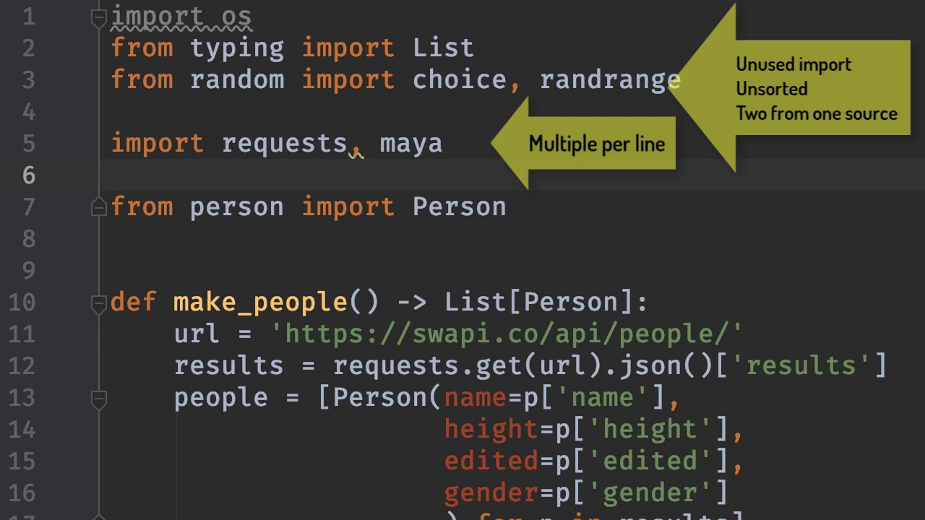
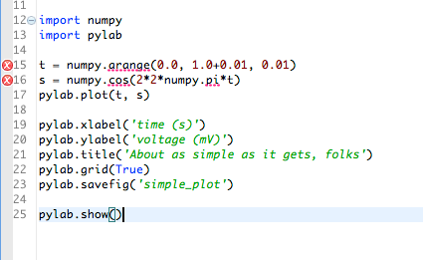
How to use libraries
Import the library into the code using the import command
Ex. import scipy
You can also import under a different name
Ex. import numpy as np
Allows for better readability of code

Slide 5
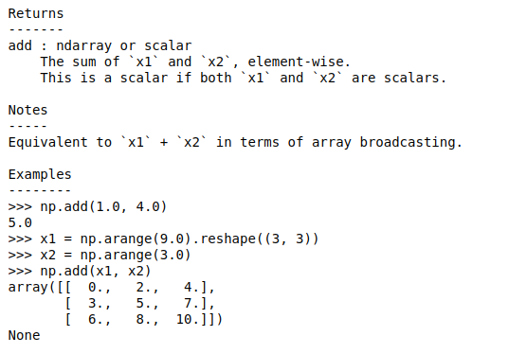
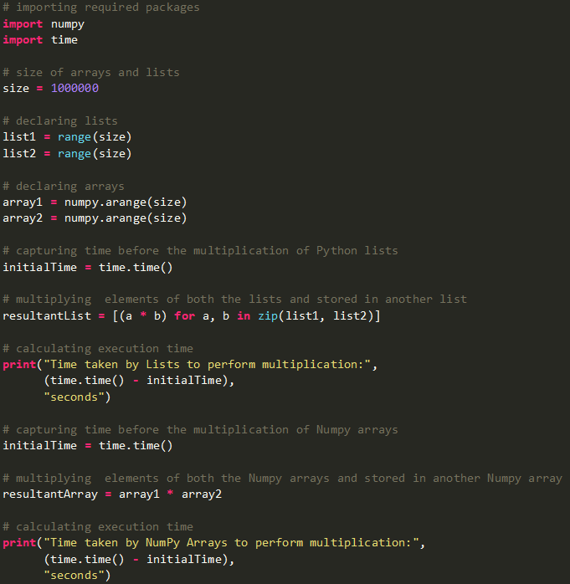
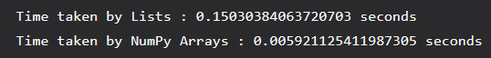
Why numpy?
Oftentimes faster than normal Python
Much wider range of functions
Generally more easy and intuitive to use
Python List
Numpy Array

Slide 6
Aside: why is numpy faster?
Numpy objects are of type “ndarray”, not a regular python list
All objects must have the same type - occupy the same space in memory
Numpy uses precompiled C code to perform looping tasks
Python List
Numpy Array

Slide 7
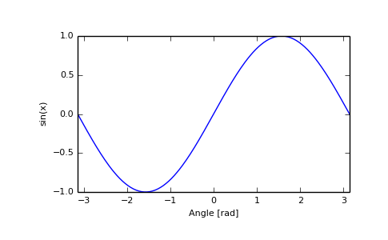
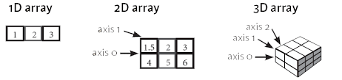
Soooo… what can we do with numpy?
Array manipulation
Add, multiply, etc.
Other functions
Sin, cosine, etc.
Focus on the former application

Slide 8
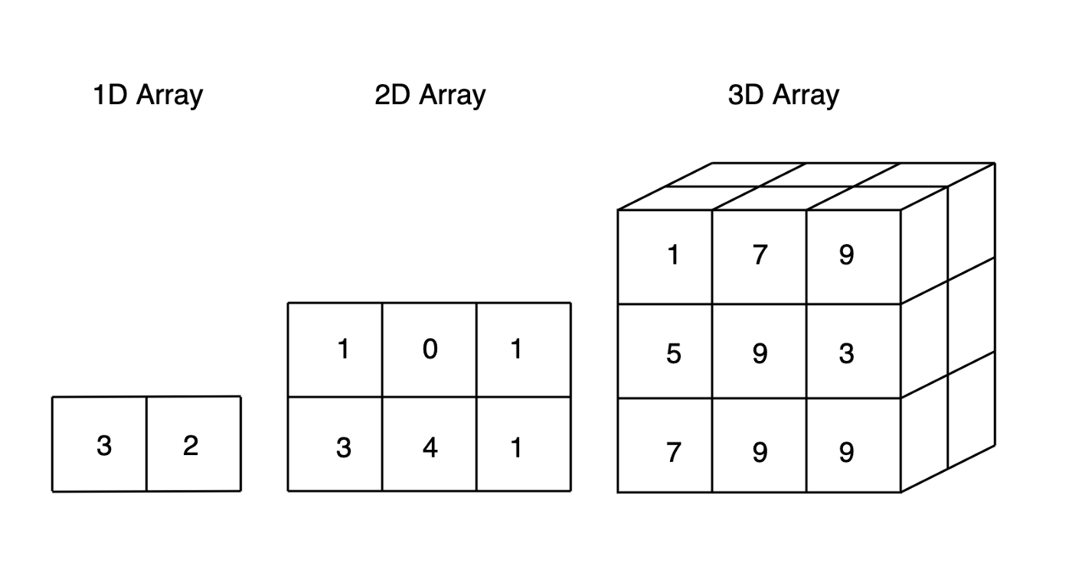
Working with numpy arrays
We can create a numpy array by using the np.array([a, b, c]) function
You can also create arrays with multiple dimensions
climate_data = np.array([[73, 67, 43],
[91, 88, 64],
[87, 134, 58],
[102, 43, 37],
[69, 96, 70]])
What do they remind you of?
Numpy array items have the ndarray data type
Source of array: https://jovian.ai/learn/data-analysis-with-python-zero-to-pandas/lesson/lesson-3-numerical-computing-with-numpy

Slide 9
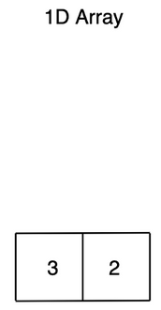
Getting started with numpy
Import the library
Importing as np
import numpy as np
Create 1-D array with np.array()
arr = np.array([1, 2, 3, 4, 5])
Print the array
print(arr)
Notes:
Importing as np means we do not have to type numpy.function when calling numpy’s functions

Slide 10
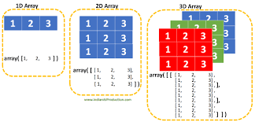
Arrays of multiple dimensions
Arrays of multiple dimensions are also possible with numpy
import numpy as np
arr = np.array([[1, 2, 3], [4, 5, 6]])
print(arr)
arr.ndim outputs the number of dimensions
What is it in this case?

Slide 11
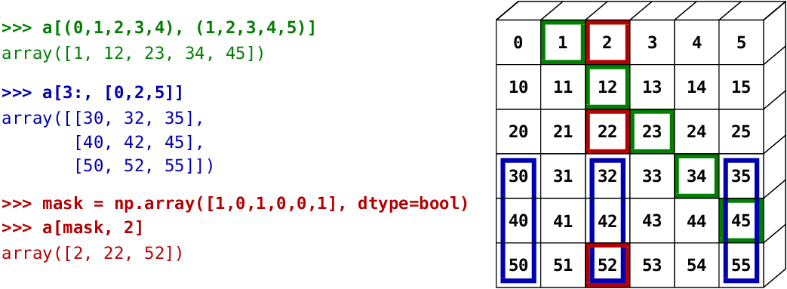
Accessing items in arrays
In general, use array[index] format
import numpy as np
import numpy as np
What number is printed in each case?
arr = np.array([[1,2,3,4,5], [6,7,8,9,10]])
print('5th element on 2nd row: ', arr[1, 4])
arr = np.array([[[1, 2, 3], [4, 5, 6]], [[7, 8, 9], [10, 11, 12]]])
print(arr[0, 1, 2])
Notes:
10, 6

Slide 12
Operations on numpy arrays
Basic operators (add, subtract, multiply, divide)
np.arange(start, stop, step)
Returns values in a given interval
Similar to linspace
np.sin(x)
np.cos(x)
np.exp(x)
np.sqrt(x)
np.dot(x, y)
Compute dot product of two vectors

Slide 13
Operations on numpy arrays
Basic operators (add, subtract, multiply, divide)
arr = np.array([1, 2, 3, 4, 5, 6])
print(arr)
print(arr + 1)
print(arr * 2)
arr2 = np.array([3, 2, 1, 0, -1, -2])
print(arr * arr2)
[1 2 3 4 5 6]
[2 3 4 5 6 7]
[2 4 6 8 10 12]
[3 4 3 0 -5 -12]

Slide 14
Operations on numpy arrays
Basic operators (add, subtract, multiply, divide)
arr = np.array([1, 2, 3, 4, 5, 6])
print(arr)
print(arr + 1)
print(arr * 2)
arr2 = np.array([3, 2, 1, 0, -1, -2])
print(arr * arr2)

Slide 15
Array Slicing
We can use array[start:end] to retrieve portions of an array from index start to index end, not including end
Leave blank to go to the end of the array
You can also use step to specify the amount of splicing
Array[start:end:step]
Examples:
arr = np.array([1, 2, 3, 4, 5, 6, 7])
print(arr[1:5])
arr = np.array([1, 2, 3, 4, 5, 6, 7])
print(arr[4:])
arr = np.array([1, 2, 3, 4, 5, 6, 7])
print(arr[1:5:2])
Notes:
2345
567
24

Slide 16
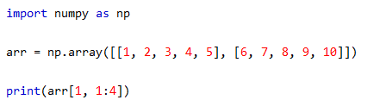
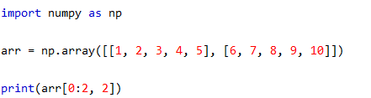
Multiple Dimension Array Slicing
Notes:
1: 2nd array , 2nd to 4th item
2: from 1st and second array the 3rd item

Slide 17
More Array Slicing
Array slicing can even be done using another array
This is called a mask and should be an array of booleans
arr = np.array([-1, 2, -3, 4, 5, -6])
print(arr>0)
arr[arr<0] = 0
print(arr)
[False True False True True False]
[0 2 0 4 5 0]
Notes:
1: 2nd array , 2nd to 4th item
2: from 1st and second array the 3rd item

Slide 18
Array shape
arr.shape return tuple with number of elements in each dimension
arr = np.array([[1, 2, 3, 4], [5, 6, 7, 8]])
print(arr.shape)
Notes:
(2, 4)

Slide 19
Challenge: the importance of array slicing
Let’s say you are working on a classifier for a person walking and you have an array with the following data:
The data comes from 10 tests
Each test took place over 100 time samples
In each time sample data was recorded from 5 points on the body
Head, hands, and feet
What is the shape of this array?
You want to perform tests on just the first test, how would you do this?
Now you want to perform tests on just the hands, how would you do this?
We will talk about this even more in future lectures
Notes:
Answers:
Shape is 10 x 100 x 5
Index: arr[0, :, :]
Index: arr[:, :, 1:3]

Slide 20
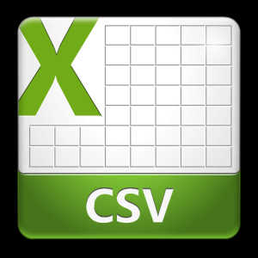
Importing Data
Use numpy’s genfromtxt function to import data from .csv files
import urllib.request
urllib.request.urlretrieve(
'https://gist.github.com/BirajCoder/a4ffcb76fd6fb221d76ac2ee2b8584e9/raw/4054f90adfd361b7aa4255e99c2e874664094cea/climate.csv', 'climate.txt')
Retrieve online resource
Skip lines at beginning
File
climate_data = np.genfromtxt('climate.txt', delimiter=',', skip_header=1)
Separating item
now contains numpy array for aclimate_data analysis!

Slide 21

Additional functions in numpy
Many numerical functions!
Examples of numpy functions:
sin(), cos(), tan()
exp()
around(), ciel(), floor()
add(), subtract()
isreal()
sqrt()
…and many more!
linspace(start, stop, num): generate num numbers from start to stop
Important when plotting
For more information, click this link: https://www.geeksforgeeks.org/numpy-mathematical-function/
Happy numpy-ing!

